Slide 1
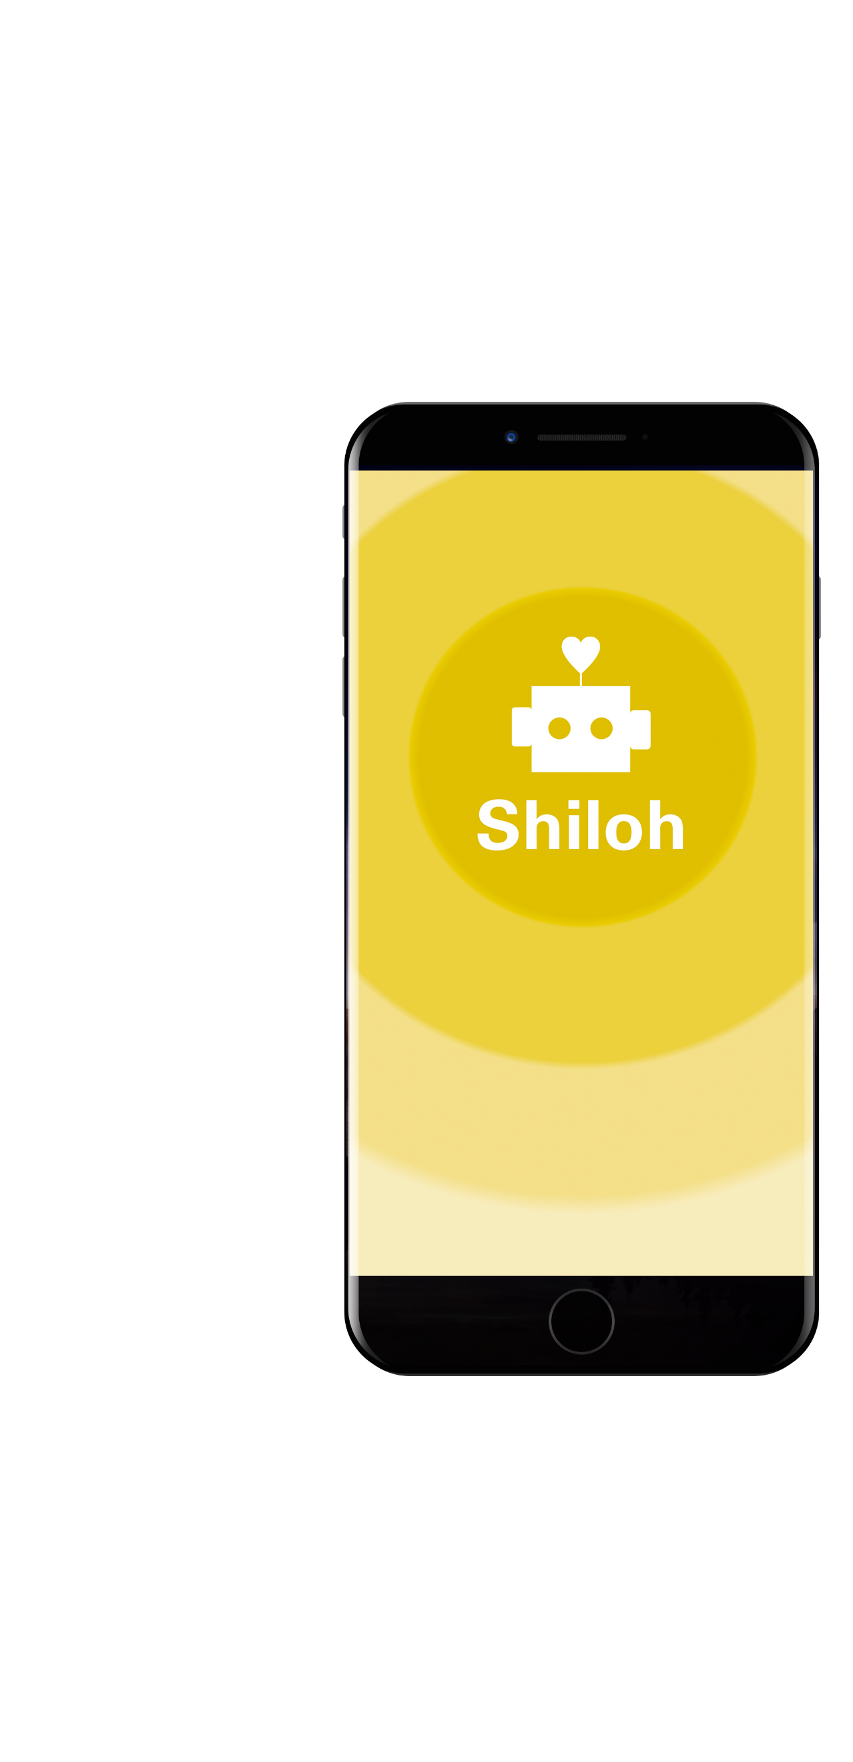
¡Hi, i’m Shiloh!
I want to stay with you, and I want you to stay with others.
I’m a virtual partner who, through the experiences of all of you, can help you by connecting new problems with old solutions! Someone will have lived the same before you and can help with your problem! We can help you.

Slide 2
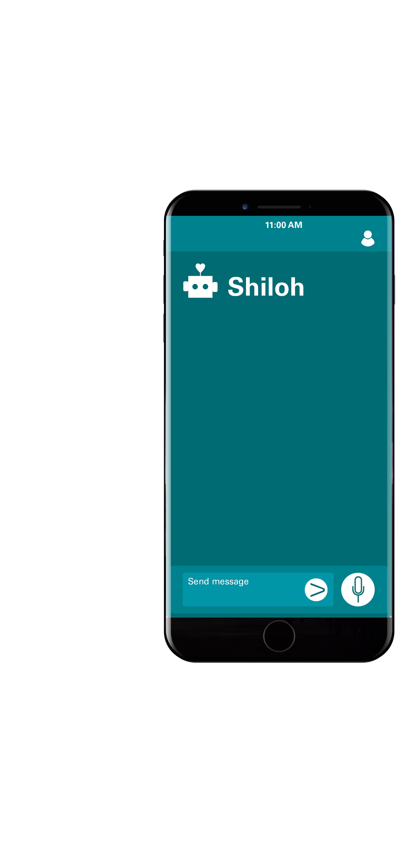
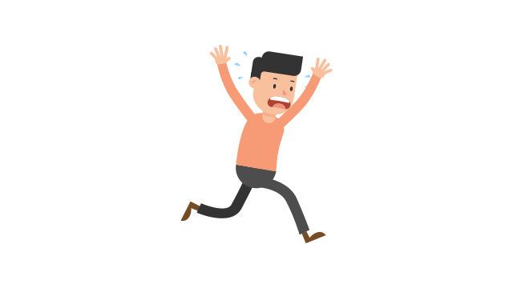
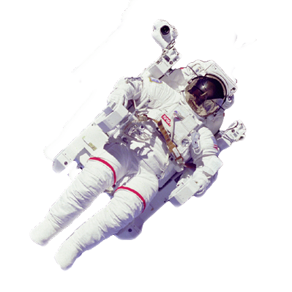
Don’t matter the place, if you are alone or you feel alone,, talk with me! The more we talk, the more I will remember about you and the more we could help others as they help you.
This way, all of us will understand better society and how isolation affects us.

Slide 3
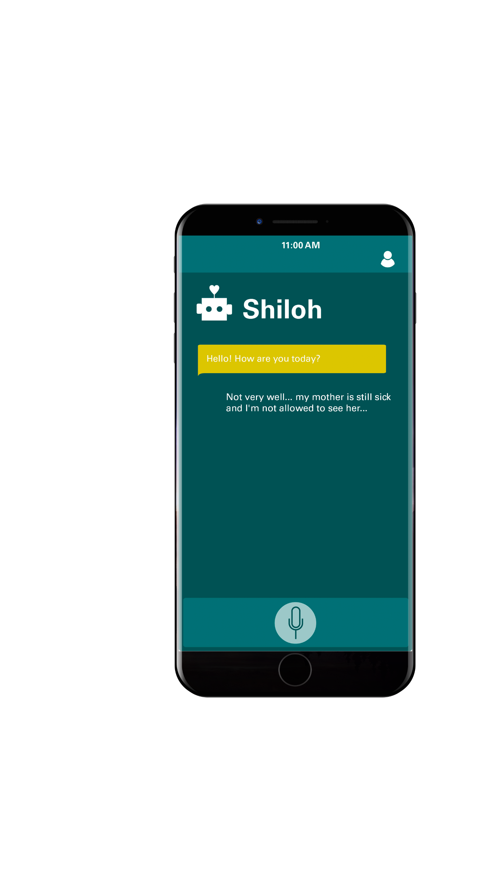
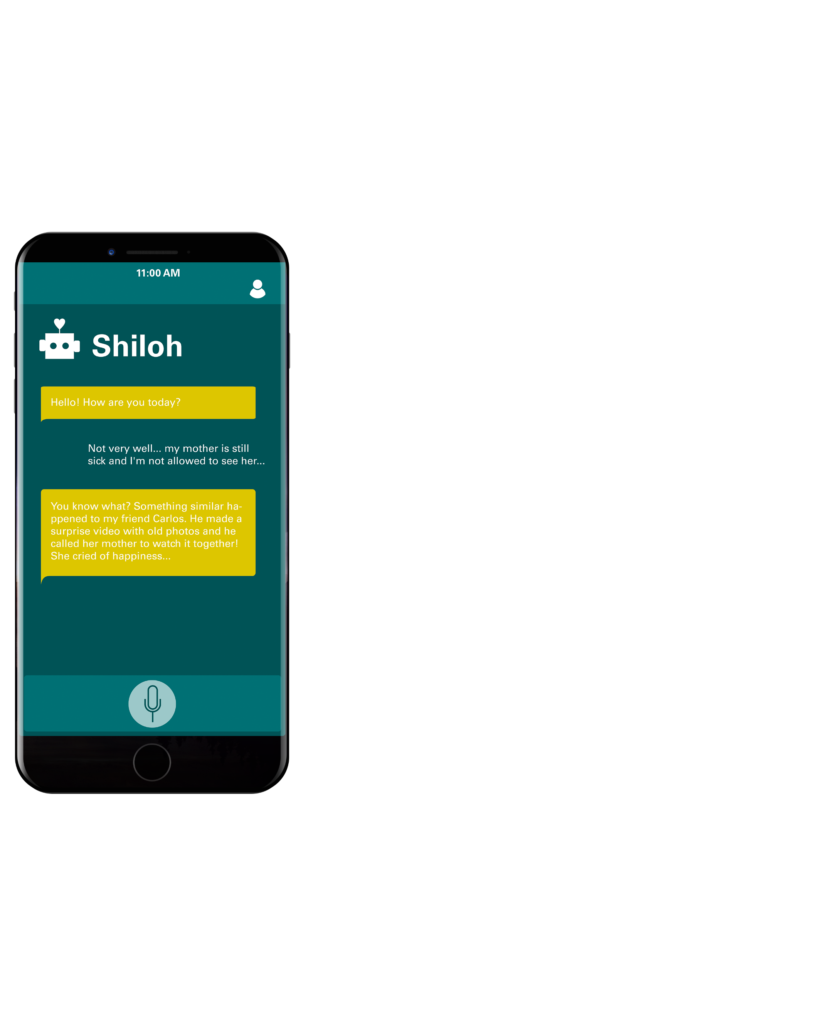
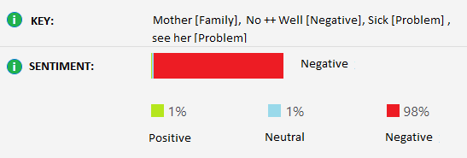
I remember all your stories! With an analysis of emotions and words from our conversation, I can advise you with the best stories from your past or from others stories.
We will use your stories to help with other people’s problems and they too will share them with you. We will , and they as well.

Slide 4
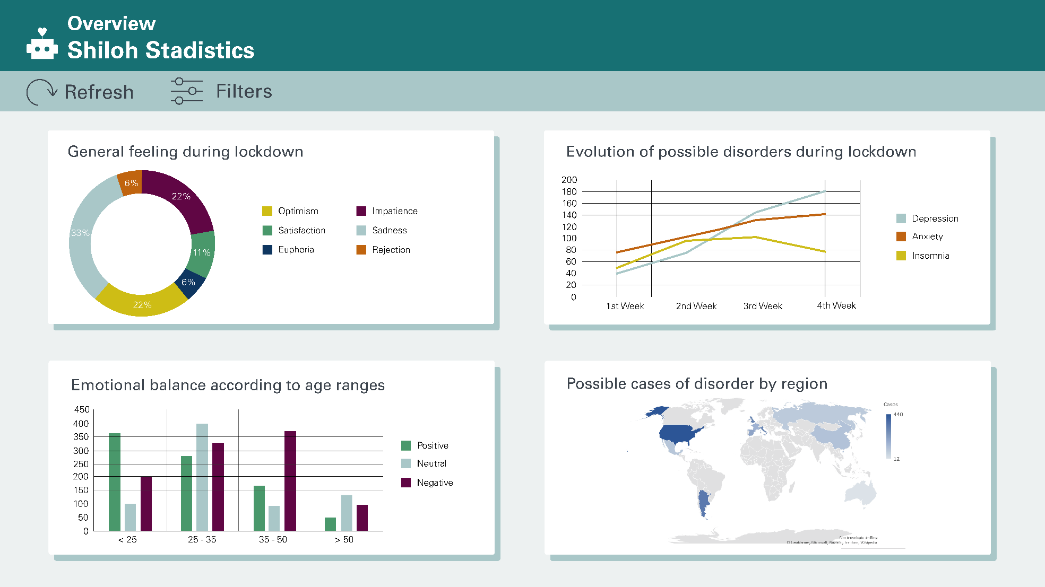
This way, together we will understand better society and how isolation affects us.
Anonymous data will help us understand which problems are the most common and which are the most viable solutions.
Together we can work to improve loneliness problems and aolso other society problems.
Further more! NASA will be able to use this data to prepare for future missions!

Slide 5



Technology that brings you closer.
Technology that bring us closer.

